Slide 1


Sentiment Classification
NLP Final
Logan Roach
Mark Stiles
Natural Language Processing - IST 664
March 6, 2024

Slide 2

Challenge

Slide 3
Dataset
Source: Stanford's Large Movie Review Dataset
Source: https://ai.stanford.edu/~amaas/data/sentiment/
Example: Negative
This is one of the most awful movies I've had the misfortune of picking up. Don't get me wrong, I love a good zombie flick, but this wasn't one of them.It had absolutely nothing to do with the other movie or the video game (as far as I could tell.)
The best aspect of the film is how the two main characters can get covered with so much blood and remain so nonplussed. I would certainly suggest giving this one and miss and staying with a safer zombie pleaser like '28 Days Later' or 'Dawn of the Living Dead' (the remake, of course, unless you're into some serious campy action.)

Slide 4
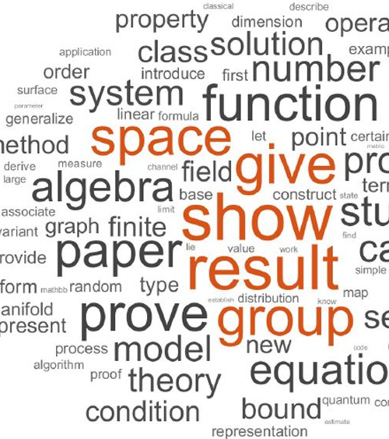
Training
Naive Bayes Classifier
5 Fold Cross Validation
12 Experiments
36 Trained Classifiers
Over 5 hours to run

Slide 5

Experiments

Slide 6
Bag-of-Words
Feature set that is a collection of words, disregarding grammar and word order, focusing solely on the presence or absence of words within the text.
Notes:
Feature set that is a collection of words, disregarding grammar and word order, focusing solely on the presence or absence of words within the text.
The sub_bow_features and generate_bow_features work together to build a bag-of-words feature set for all the reviews. The generate function takes care of the initial tokenization and word frequency distribution so it's not repeatedly being created and then iterates through each review while calling the sub function. The sub function then builds the features for each individual review.

Slide 7
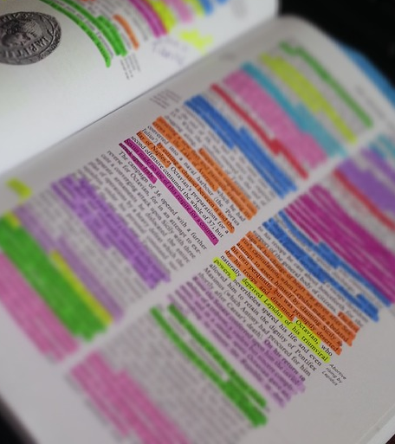
Parts-of-Speech
Conjugations
Determiners
Nouns
Verbs
Adjectives
Adverbs
Particles
Markers
Numerical
Foreign Words
Symbols
Interjections
To
Existential there (ex)
Possessive Endings (pos)
Notes:
Parts of Speech we are interested in: conjugation, determiner, noun, verb, adjective, adverb, particle, marker, numerical, foreign words, symbols, interjection, to, ex (existential there) and pos (possessive endings).
We did a few experiments using different parts of speech. These experiments include using all parts of speech, experiments where one part of speech is removed at a time to see if there are any performance improvements, an experiment to see what happens when we remove all parts of speech and then using counts of parts of speech within a review. The goal is to determine if the volume of parts-of-speech tags are any indication of a positive or negative review.
(next slide)
The sub_pos_features and generate_pos_features functions work together to build a parts-of-speech feature set for all the reviews. The generate function iterates through each review while calling the sub function. The sub function first tokenizes and tags the review text with parts-of-speech and then builds a frequency distribution of the tags to then pass to the count_tags function to build the features for each individual review.

Slide 8
Parts-of-Speech
Results When Including All POS
Accuracy ranges from 81.86% to 83.88%
Precision, recall and F1 scores are similar with respect to accuracy
The most indicative features were words like "pointless," "laughable," and "waste"associated with negative sentiment.
Mean accuracy across all rounds was 83.14%
Notes:
Results When Including All POS, before generating the bag-of-words features, what is left is only what it could not define
Accuracy ranges from 81.86% to 83.88%
Precision, recall and F1 scores are similar with respect to accuracy
The most indicative features were words like "pointless," "laughable," and "waste"associated with negative sentiment.
Mean accuracy across all rounds was 83.14% suggesting the model is reasonably accurate in sentiment classification, but with room for improvement.

Slide 9
Parts-of-Speech
Results When Removing Nouns
Accuracy ranges from 83.7% to 85.6%
Precision, recall and F1 scores are similar with respect to accuracy
The most indicative features were "7/10”, which was associated with positive sentiment, and "3/10,” and "4/10," were associated with negative sentiment
Mean accuracy across all rounds was 84.61%
Notes:
Removing noun parts of speech gave the best results
Accuracy ranges from 83.7% to 85.6%
Precision, recall and F1 scores are similar with respect to accuracy
The most indicative features were "7/10”, which was associated with positive sentiment, and "3/10,” and "4/10," were associated with negative sentiment
Mean accuracy across all rounds was 84.61% (higher than the baseline using all POS)

Slide 10
Parts-of-Speech
Results When Removing All POS
Accuracy ranges from 58.86% to 60.26%
Precision, recall and F1 scores are similar with respect to accuracy
The most indicative features were "winchester," "hanzo," and "zombi" where the first two are associated with positive sentiment and the last associated with negative sentiment.
Mean accuracy across all rounds was 59.53% (not good)
Notes:
Results When Removing All POS before generating the bag-of-words features, what is left is only what it could not define
Accuracy ranges from 58.86% to 60.26%
Precision, recall and F1 scores are similar with respect to accuracy
The most indicative features were "winchester," "hanzo," and "zombi" where the first two are associated with positive sentiment and the last associated with negative sentiment.
Mean accuracy across all rounds was 59.53% (not good)

Slide 11
Parts-of-Speech
Results When Using POS Counts
Accuracy ranges from 52.4 % to 55.48%
Precision, recall and F1 scores for classifying negative sentiment was slightly higher than classifying positive sentiment
The most indicative features were" verb_count" and “noun_count” associated with positive sentiment, and "determ_count" associated with negative sentiment
Mean accuracy across all rounds was 54.74%
Notes:
Results When Using POS Counts (The goal is to determine if the volume of parts-of-speech tags are any indication of a positive or negative review.)
Accuracy ranges from 52.4 % to 55.48%
Precision, recall and F1 scores for classifying negative sentiment was slightly higher than classifying positive sentiment
The most indicative features were" verb_count" and “noun_count” associated with positive sentiment, and "determ_count" associated with negative sentiment
Mean accuracy across all rounds was 54.74% (not good)

Slide 12

Text Statistics
Results
Accuracy ranges from 51.38% to 52.76%
Precision, recall and F1 scores are similar with respect to accuracy
The most indicative features were “review_length” followed by “cap_count” where they were all associated with negative sentiment
Mean accuracy across all rounds was 51.87%%
Notes:
Here, we tried to find insights by counting the number of capital letters, measuring the length of the review and average word length. There may be a relationship between how lengthy or concise a review is, the overuse of caps or even the word complexity (more syllables).
Results:
accuracy ranged from 51.38% to 52.76% across all five rounds
precision, recall and F1 score sare similar with respect to accuracy
The most indicative features were “review_length” followed by “cap_count” where they were all associated with negative sentiment
The mean accuracy across all rounds was found to be 51.87% (not good)

Slide 13
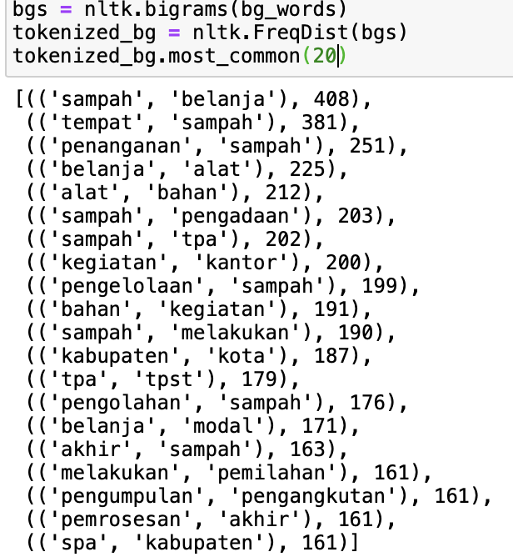
Bi-Grams
Results
Accuracy ranges from 48.88% to 49.98%
Precision, recall and F1 scores to be slightly higher in the positive class than the negative class
The most indicative features were negated bigram feature where they were all associated with negative sentiment
Mean accuracy across all rounds was 49.33%
Notes:
This experiment uses bi-grams collected from the review corpus to generate features from to identify common two word phrases to indicate if the review is negative or positive.
Results:
accuracy ranged from 48.88% to 49.98% across all five rounds
precision, recall and F1 scores to be slightly higher in the positive class than the negative class
The most indicative features were negated bigram feature where they were all associated with negative sentiment
The mean accuracy across all rounds was found to be 49.33% (not good)

Slide 14

Nots
Results
Accuracy ranges from 57.74% to 59.12%
Precision, recall and F1 scores to be slightly higher in the positive class than the negative class
The most indicative features were the number of “not_counts” found within the reviews where they were all associated with negative sentiment
Mean accuracy across all rounds was 58.33%
Notes:
In this experiment, the goal was to generate features that counts the number of 'not' words. The outcome should indicate if this statistic is a good barometer of sentiment.
Results
accuracy ranges from 57.74% to 59.12%
precision, recall and F1 scores to be slightly higher in the positive class than the negative class
The most indicative features were the number of “not_counts” found within the reviews where they were all associated with negative sentiment
mean accuracy across all rounds was 58.33% :(

Slide 15
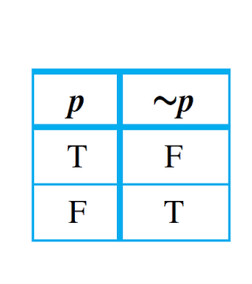
Negations
Results
Accuracy ranges from 48.88% to 49.98%
Interestingly, only one class of sentiment had perfect precision and the other had a precision of zero
The indicative features used to distinguish sentiment were “not_&” and “not_the” which are strongly associated with negative sentiment.
Mean accuracy across all rounds was 49.33%
Notes:
This experiment is similar to the previous one but, instead of counting the not words we are trying to indicate which words are contradicted. Not all words were indicated, and this only used the most common words by frequency to determine if each review contained a contradicted version of that word.
Results
accuracy ranges from 48.88% to 49.98%
Interestingly, only one class of sentiment had perfect precision and the other had a precision of zero.
Where the model precision was perfect, the recall hovered around 49%, and the F1 score was about 66%.
When the precision of one of the sentiment classes was 0.0 the recall and the F1 score were also 0.0.
The same phenomenon that occurred when using the bigram feature set suggesting sets could be composed of wholly negated pairs of top word or perhaps double negated words when the positive class precision is 100% accurate.
The indicative features used to distinguish sentiment were “not_&” and “not_the” which are strongly associated with negative sentiment.
mean accuracy across all rounds was 49.33% (real bad)

Slide 16
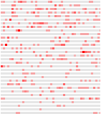
TF-IDF
Results
Accuracy ranges from 80.86% to 82.68%
Precision, recall and F1 scores to be slightly higher in the positive class than the negative class
The indicative features used to distinguish sentiment were "waste," "pointless," and "worst" which are strongly associated with negative sentiment.
Mean accuracy across all rounds was 82.14%
Notes:
This experiment is similar to the bag-of-words features in experiments 1-3. The TF-IDF uses frequency number countered by overuse. If a word is used a lot it is probably a good word to compare against but if it's used too much then it loses its meaning and should be penalized. This test should determine how this compares to the bag-of-words tests.
The tfidf_tokenizer function is used by the TF-IDF Vectorizer to tokenize the review text.
Results
accuracy ranges from 80.86% to 82.68%
precision, recall and F1 scores to be slightly higher in the positive class than the negative class
he indicative features used to distinguish sentiment were "waste," "pointless," and "worst" which are strongly associated with negative sentiment.
mean accuracy across all rounds was 82.14%, slightly worse than the first experiment using all parts of speech and the bag of words feature set

Slide 17

Vader
Results
Accuracy ranges from 69.08% to 70.54%
Precision, recall and F1 scores to be slightly higher in the positive class than the negative class
The absence of sentiment (S_vader = False) is more indicative of the negative class, while the presence of sentiment (S_vader = True) is more indicative of the positive class
Mean accuracy across all rounds was found to be 69.92%
Notes:
In this experiment, we tried using Vader Sentiment Analysis, a 3rd party sentiment library to generate features with a sentiment value. In testing it was never completely accurate but may provide some improved accuracy
Results
accuracy ranges from 69.08% to 70.54%
precision, recall and F1 scores to be slightly higher in the positive class than the negative class
the absence of sentiment (S_vader = False) is more indicative of the negative class, while the presence of sentiment (S_vader = True) is more indicative of the positive class
mean accuracy across all rounds was found to be 69.92%, showing a moderate performance but not as good as performance from Experiment 1 or Experiment 2

Slide 18
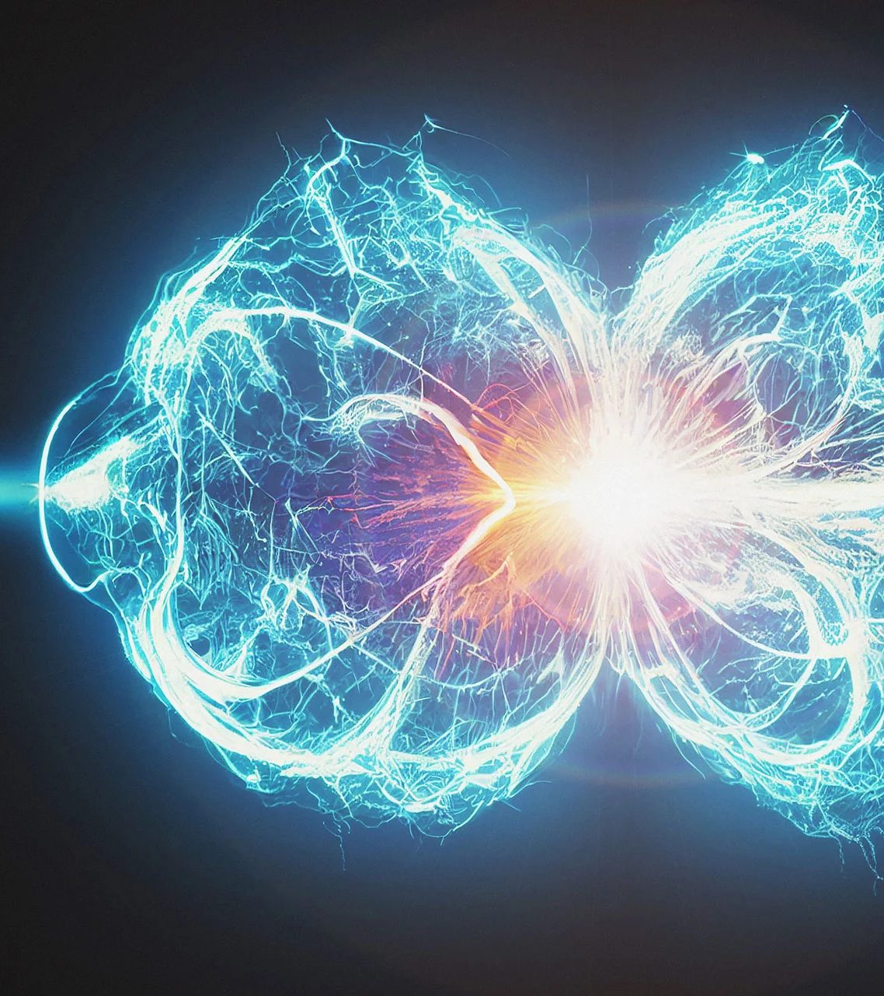
Combination 1
Results
Accuracy ranged from 82.9% to 84.72% across all five rounds
Precision, recall and F1 scores to be slightly higher in the positive class than the negative class
The most informative features were a combination of features from the merged list of features: "TF_waste" and "V_pointless" were found to be associated with negative sentiment.
The mean accuracy across all rounds was found to be 83.92%
Vader, TF-IDF and Bag-of-Words (all words)
Notes:
Our goal with this experiment is to combines features from previous tests to create a set that has a higher score than each individual feature set. In this case the features from Vader, TF-IDF and Bag-of-Words (all words) were used.
Results:
accuracy ranged from 82.9% to 84.72% across all five rounds
precision, recall and F1 scores to be slightly higher in the positive class than the negative class
The most informative features were a combination of features from the merged list of features. For example, TF_DIF vectorized features like "TF_waste" and sentiment features like "V_pointless" were found to be associated with negative sentiment.
The mean accuracy across all rounds was found to be 83.92% (just slightly higher than the baseline of experiment 1)

Slide 19

Combination 2
Results
Accuracy ranged from 84.02% to 85.54% across all five rounds
Precision, recall and F1 scores being slightly higher in the positive class than the negative class
Since nouns were removed the most informative features seen are ratings seen previously when removing nouns: "3/10," "4/10," and "7/10”
Mean accuracy across all rounds is found to be 85.07%, the most promising results from the model across all experiments and iterations
Vader, TF-IDF and Bag-of-Words (with nouns removed)
Notes:
Our goal with this experiment is to see if we could improve results using combined features from Vader, TF-IDF and Bag-of-Words (with nouns removed).
accuracy ranged from 84.02% to 85.54% across all five rounds
precision, recall and F1 scores being slightly higher in the positive class than the negative class
Since nouns were removed the most informative features seen are ratings seen previously when removing nouns: "3/10," "4/10," and "7/10”
mean accuracy across all rounds is found to be 85.07%, the most promising results from the model across all experiments and iterations

Slide 20

85%
Best Accuracy
Combination 2
Notes:
The performance from the second combination experiment show the most promising results from combining the features from Vader, TF-IDF and Bag-of-Words (with nouns removed)

Slide 21
Additional Thoughts
Wanted more time for
Analyzing the reviews manually for clues
Customizing tokenization for individual features
Developing additional features
Use additional test data set
Develop a vocabulary for this domain
Insights
Very challenging to map the varied structure of language
Flexibility of language is so complex and arbitrary
Domain context could improve accuracy

Slide 22

Thank You

